Slide 1

Customer Shopping Behavior Analysis
Actionable insights from customer transaction data
Developed By – Rohit Das

Slide 2

Dataset Overview
3,900
18
37
Total Purchases
Data Columns
Missing Values
Comprehensive transaction data
Customer demographics & behavior
Only in Review Rating column

Slide 3
Data Preparation Process
01
02
03
Data Loading
Initial Exploration
Missing Data Handling
Imported dataset using pandas
Structure check and summary statistics
Imputed Review Rating with median values
04
05
Feature Engineering
Database Integration
Created age groups and purchase frequency
Connected to PostgreSQL for analysis

Slide 4
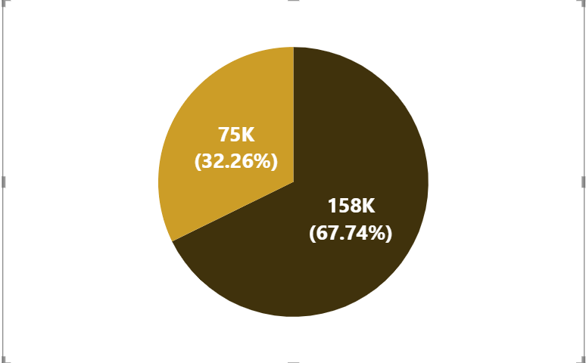

Revenue by Gender Analysis
Key Insight
Male customers generate slightly higher total revenue than Female customers
Gender-based marketing strategies could optimize revenue streams
Male
Female

Slide 5

High-Value Discount Users
Customers using discounts while spending above average
Smart Shoppers
High spenders who maximize value with discounts
Strategic Opportunity
Target premium customers with exclusive offers

Slide 6

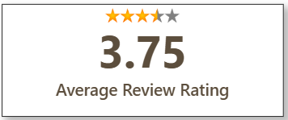


Top-Rated Products
3.86
3.84
3.82
Gloves
Sandals
Boots
Identify and fix common issues by reviewing low-rated feedback and addressing recurring problems related to product quality, fit, or delivery.
Encourage satisfied customers to leave reviews through post-purchase follow-ups, as more positive reviews will help improve the overall
rating and customer trust.

Slide 7

Shipping Preferences Impact
Express Shipping
Standard Shipping
$60
$58
Average purchase amount
Average purchase amount
Average order values are similar across shipping types, with express shipping
showing a marginally higher spend than standard shipping.

Slide 8
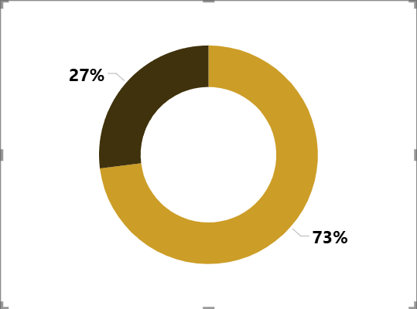
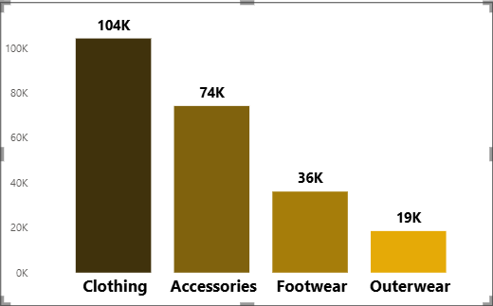
Customer Revenue Insights
Subscription Impact
Revenue By Category
Subscribers Non-Subscribers

Slide 9



Customer Segmentation
Loyal
1
79.90% - High value customers
Returning
2
17.97% - Regular shoppers
New
3
2.13% - First-time buyers
The proportion of new customers is currently very low, which limits future revenue growth and customer base expansion.
Focus customer acquisition on high-intent channels by promoting top-rated, frequently purchased products to attract relevant new buyers.
Convert them to returning customers by offering a first-purchase incentive linked to a clear second-purchase or subscription follow-up.

Slide 10
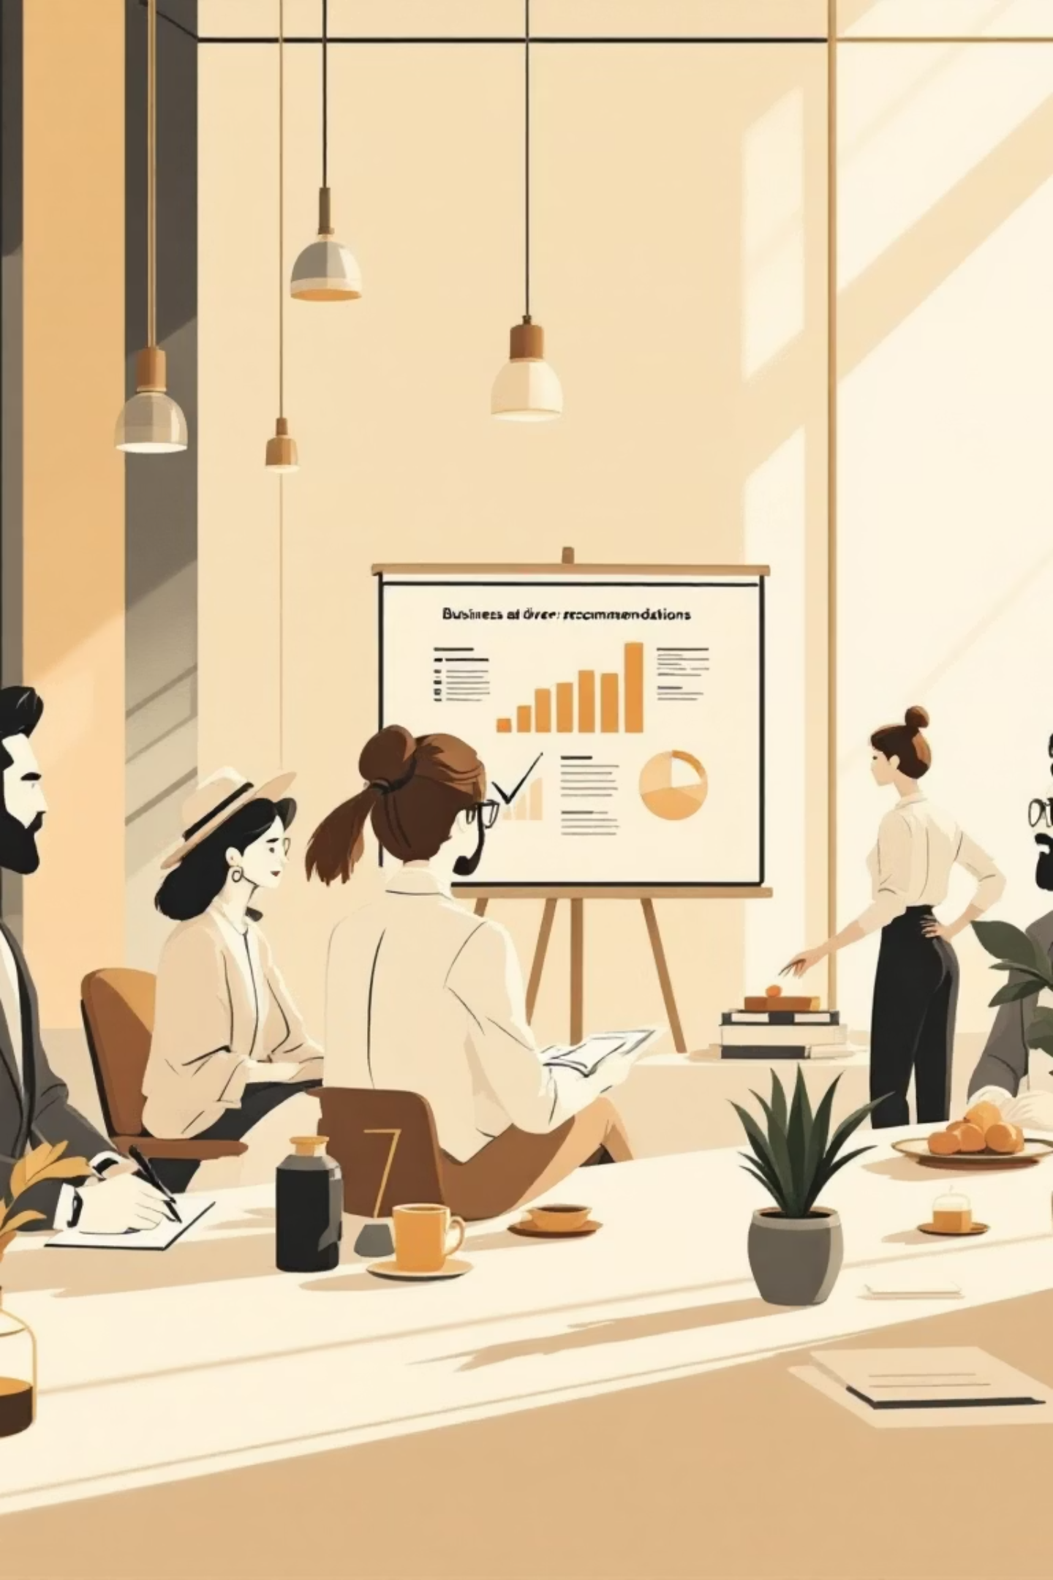




Strategic Recommendations
Boost Subscriptions
Promote exclusive benefits for subscribers
Loyalty Programs
Reward repeat buyers to increase retention
Targeted Marketing
Focus on high-revenue segments and express users
Product Positioning
Highlight top-rated products in campaigns

